Slide 1
Microservices
Chapter 7

Slide 2
Agenda
By the end of this chapter, you will learn about:
The different options, tools, and technologies for log management
The use of Spring Cloud Sleuth in tracing microservices
The different tools for end-to-end monitoring of microservices
The use of Spring Cloud Hystrix and Turbine for circuit monitoring
The use of data lakes in enabling business data analysis

Slide 3
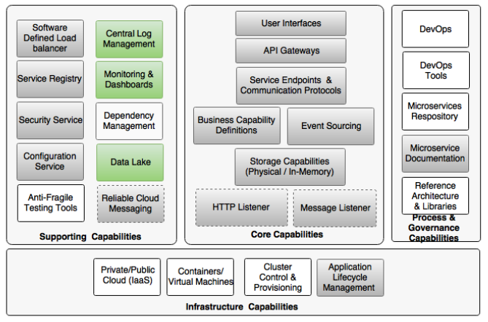
Reviewing the microservice capability model

Slide 4
Understanding log management challenges (traditionally)
Logs are streams of events coming from a running process
One of the best practices of log handling is to switch off most of the log entries in production due to:
the high cost of disk IOs
disk IOs slow down the application
they can severely impact scalability
Writing logs into the disk requires high disk capacity
But, restricting log entries essentially limits our ability to understand the application's behavior
Notes:
For traditional logging:
Log4j, Logback, and SLF4J
File recycling techniques are generally employed to avoid logs filling up all the disk space

Slide 5
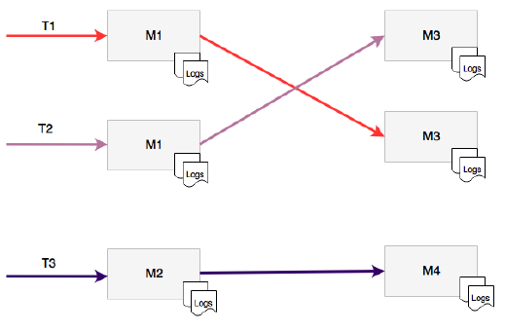
Understanding log management challenges (cloud)
Here, applications are no longer locked to a particular, predefined machine as Virtual machines and containers are not hardwired with an application
The machines used for deployment can change from time to time.
containers such as Docker are ephemeral (one cannot rely on the persistent state of the disk)
Logs written to the disk are lost once the container is
stopped and restarted
Microservices they will run on isolated physical or virtual
machines, resulting in fragmented log files →
it is almost impossible to trace end-to-end transactions
that span multiple microservices →
log aggregation at the service level is hard to achieve
Notes:
For traditional logging:
Log4j, Logback, and SLF4J
File recycling techniques are generally employed to avoid logs filling up all the disk space

Slide 6
A centralized logging solution
We need:
The ability to collect all log messages and run analytics on top of the log messages
The ability to correlate and track transactions end to end
The ability to keep log information for longer time periods for trending and forecasting
The ability to eliminate dependency on the local disk system
The ability to aggregate log information coming from multiple sources such as network devices, operating system, microservices, and so on

Slide 7
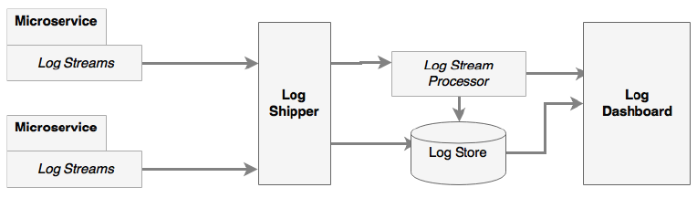
A centralized logging solution (Cont.)
Solution:
centrally store and analyze all log messages, irrespective of the source of log by detaching log storage and processing from service execution environments
Log analysis and processing will be handled using big data solutions
Notes:
centralized logging solution components:
Log streams: These are streams of log messages coming out of source systems. The source system can be microservices, other applications, or even network devices. In typical Java-based systems, these are equivalent to streaming Log4j log messages.
Log shippers: Log shippers are responsible for collecting the log messages coming from different sources or endpoints. The log shippers then send these messages to another set of endpoints, such as writing to a database, pushing to a dashboard, or sending it to stream-processing endpoint for further real-time processing.
Log store: A log store is the place where all log messages are stored for real-time analysis, trending, and so on. Typically, a log store is a NoSQL database, such as HDFS, capable of handling large data volumes.
Log stream processor: The log stream processor is capable of analyzing real-time log events for quick decision making. A stream processor takes actions such as sending information to a dashboard, sending alerts, and so on. In the case of self-healing systems, stream processors can even take actions to correct the problems.
Log dashboard: A dashboard is a single pane of glass used to display log analysis results such as graphs and charts. These dashboards are meant for the operational and management staff.

Slide 8
What do we need
It is important to have in each log message
a context,
message, and
correlation ID.
The context typically has the timestamp, IP address, user information, process details (such as service, class, and functions), log type, classification, and so on.
The message will be plain and simple free text information.
The correlation ID is used to establish the link between service calls so that calls spanning microservices can be traced
Notes:
This is similar to http://lambda-architecture.net/

Slide 9
The selection of logging solutions
Cloud services
Projects:
Loggly's Log4j
AWS CloudTrail
Papertrial
Logsene
Sumo Logi
Google Cloud Logging
Logentries
Pros:
take away the overhead of managing complex infrastructures and large storage solutions
providing simple-to-integrate services.
Cons:
latency
Off-the-shelf solutions
Best-of-breed integration
A Custom Logging implementation
Distributed Tracing using Spring Cloud Sleuth
Logback

Slide 10
The selection of logging solutions
Cloud services
Off-the-shelf solutions
Projects:
Graylog (uses Elasticsearch for log storage and MongoDB as a metadata store, GELF libraries for Log4j log streaming)
Splunk (uses log file shipping approach)
Pros:
purpose-built tools to provide end-to-end log management capabilities, installable locally in an on-premises data center or in the cloud.
Best-of-breed integration
A Custom Logging implementation
Distributed Tracing using Spring Cloud Sleuth

Slide 11
The selection of logging solutions
Cloud services
Off-the-shelf solutions
Best-of-breed integration
Log shippers
Tools:
Logstash: powerful data pipeline tool. used to collect and ship log files, broker that provides a mechanism to accept streaming data from different sources and sync them to different destinations. Uses Log4j and Logback. Connected to Elasticsearch, HDFS, or any other database
Fluentd: like Logstash, but more appropriate in a Docker container-based environment.
Log stream processors:
used to process log streams on the fly
Flume and Kafka together with either Storm or Spark Streaming
Log4j has Flume appenders: useful to collect log messages
These messages are pushed into distributed Kafka message queues
stream processors collect data from Kafka and process them on the fly before sending it to Elasticsearch and other log stores
Projects:
Spring Cloud Stream
Spring Cloud Stream Modules
Spring Cloud Data Flow
Log storage
Real-time log messages are typically stored in Elasticsearch
Elasticsearch allows clients to query based on text-based indexes
Projects:
Elasticsearch
HDFS
MongoDB (for summary data)
Cassandra (for summary data)
Hadoop's MapReduce (for offline log processing)
Dashboards
Projects:
Kibana (on top of Elasticsearch data store
Graphite
Grafana
A Custom Logging implementation
Distributed Tracing using Spring Cloud Sleuth

Slide 12
The selection of logging solutions
Cloud services
Off-the-shelf solutions
Best-of-breed integration
A Custom Logging implementation
Most Commonly used architecture for custom log management is “ELK stack”:
Elasticsearch,
Logstash,
Kibana,
Distributed Tracing using Spring Cloud Sleuth

Slide 13
The selection of logging solutions
Cloud services
Off-the-shelf solutions
Best-of-breed integration
A Custom Logging implementation
Distributed Tracing using Spring Cloud Sleuth
it is still almost impossible to trace end-to-end transactions. That’s why transactions spanning microservices need to have a correlation ID.
distributed tracing Systems (Projects):
Twitter's Zipkin
Cloudera's Htrace
Google's Dapper
Spring Cloud Sleuth library is a wrapper component on top of these systems
Works with concepts Span & Trace

Slide 14
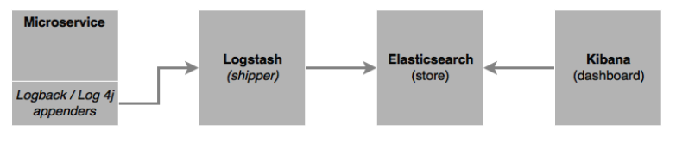
ELK Stack
For steps on implementing ELK stack, check out pages [290-293]
Notes:
It is worth mentioning that the code overrides the default Logback configuration by adding a new TCP socket appender, which streams all the log messages to a Logstash service, which is listening on port 4560. It is important to add an encoder, as mentioned in the mentioned configuration.

Slide 15

span and trace
The span is a unit of work
For example: calling a service is identified by a 64-bit span ID
The trace is A set of spans to form a tree-like structure
Using the trace ID, the call can be tracked end to end
Check out code in pages [294-297] to test this.
Notes:
In the diagram: the same trace ID is passed across all microservices, which can be used to track transactions end to end.

Slide 16
Microservice Monitoring Challenges
there are many moving parts in a microservice ecosystem. Typical Issues:
The statistics and metrics are fragmented across many services, instances, and machines.
Heterogeneous technologies may be used to implement microservices, which makes things even more complex. A single monitoring tool may not give all the required monitoring options.
Microservices deployment topologies are dynamic, making it impossible to preconfigure servers, instances, and monitoring parameters.
Many traditional tools need baseline metrics **
Notes:
Many traditional tools need baseline metrics such as if the CPU utilization goes above 60% and remains at this level for 2 minutes, then an alert should be sent to the administrator. It is extremely hard to preconfigure these values in large, Internet-scale deployments.

Slide 17
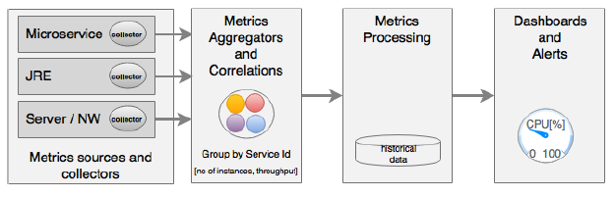
key areas of microservices monitoring
Notes:
Metrics sources and data collectors: Metrics collection at the source is done either by the server pushing metrics information to a central collector or by embedding lightweight agents to collect information. Data collectors collect monitoring metrics from different sources, such as network, physical machines, containers, software components, applications, and so on. The challenge is to collect this data using auto-discovery mechanisms instead of static configurations.
This is done by either running agents on the source machines, streaming data from the sources, or polling at regular intervals.
Aggregation and correlation of metrics: Aggregation capability is required for aggregating metrics collected from different sources, such as user transaction, service, infrastructure, network, and so on. Aggregation can be challenging as it requires some level of understanding of the application’s behavior, such as service dependencies, service grouping, and so on. In many cases, these are automatically formulated based on the metadata provided by the sources.
Generally, this is done by an intermediary that accept the metrics.
Processing metrics and actionable insights: Once data is aggregated, the next step is to do the measurement. Measurements are typically done using set thresholds. In the new-generation monitoring systems, these thresholds are automatically discovered. Monitoring tools then analyze the data and provide actionable insights.
These tools may use big data and stream analytics solutions.
Alerting, actions, and dashboards: As soon as issues are detected, they have to be notified to the relevant people or systems. Unlike traditional systems, the microservices monitoring systems should be capable of taking actions on a real-time basis. Proactive monitoring is essential to achieving self-healing. Dashboards are used to display SLAs, KPIs, and so on. Dashboards and alerting tools are capable of handling these requirements.
Microservice monitoring is typically done with three approaches. A combination of these is really required for effective monitoring:
Application performance monitoring (APM): This is more of a traditional approach to system metrics collection, processing, alerting, and dashboard rendering. These are more from the system's point of view. Application topology discovery and visualization are new capabilities implemented by many of the APM tools. The capabilities vary between different APM providers.
Synthetic monitoring: This is a technique that is used to monitor the system's behavior using end-to-end transactions with a number of test scenarios in a production or production-like environment. Data is collected to validate the system's behavior and potential hotspots. Synthetic monitoring helps understand the system dependencies as well.
Real user monitoring (RUM) or user experience monitoring: This is typically a browser-based software that records real user statistics, such as response time, availability, and service levels. With microservices, with more frequent release cycle and dynamic topology, user experience monitoring is more important.

Slide 18
Monitoring tools
AppDynamics, Dynatrace, and New Relic are top commercial vendors in the APM space
Ruxit, Datadog, and Dataloop are purpose-built for distributed systems
These tools are microservice friendly and support microservice monitoring effectively
AWS uses CloudWatch and Google Cloud Platform uses Cloud Monitoring to collect information from various sources.
Zabbix, statd, collectd, jmxtrans are data collecting libraries, operate at a lower level in collecting runtime statistics, metrics, gauges, and counters. this information is fed into data collectors and processors such as Riemann, Datadog, and Librato, or dashboards such as Graphite

Slide 19
Monitoring tools (Cont.)
Spring Boot Actuator, Netflix Servo, a metric collector similar to Actuator, and the QBit and Dropwizard metrics also fall in the same category of metric collectors. All these metrics collectors need an aggregator and dashboard to facilitate full-sized monitoring.
Sensu: from Open Source community.
Weave Scope: Open Source targeting containerized deployment
Spigo is a purpose-built microservices monitoring systems closely aligned with the Netflix stack
Pingdom, New Relic Synthetics, Runscope, Catchpoint provide options for synthetic transaction monitoring and user experience monitoring on live systems.

Slide 20
Monitoring tools (Cont.)
Circonus: DevOps monitoring tool, which can also be used for microservices
Nagios: popular open source monitoring tool, but falls more into the traditional monitoring system
Prometheus: time series database and visualization GUI useful in building custom monitoring tools

Slide 21
Monitoring microservice dependencies
Mentoring tools such as AppDynamics, Dynatrace, and New Relic can draw dependencies among microservices
End-to-end transaction monitoring can also trace transaction dependencies
Also, Spigo
CMDB tools such as Device42 or purpose-built tools such as Accordance are useful in managing the dependency of microservices. Veritas Risk Advisor (VRA) is also useful for infrastructure discovery.
A custom implementation with a Graph database, such as Neo4j, is also useful. microservice has to preconfigure its direct and indirect dependencies. At the startup of the service, it publishes and cross-checks its dependencies with a Neo4j database

Slide 22
Spring Cloud Hystrix for fault-tolerant microservices
Hystrix is based on the fail fast and rapid recovery principles.
If there is an issue with a service, Hystrix helps isolate it.
It helps to recover quickly by falling back to another preconfigured fallback service.
Hystrix is based on the circuit breaker pattern **
To change the Search API Gateway service to integrate it with Hystrix, check out pages [302-306] of the book
Notes:
** Check out at https://docs.microsoft.com/en-us/azure/architecture/patterns/circuit-breaker

Slide 23
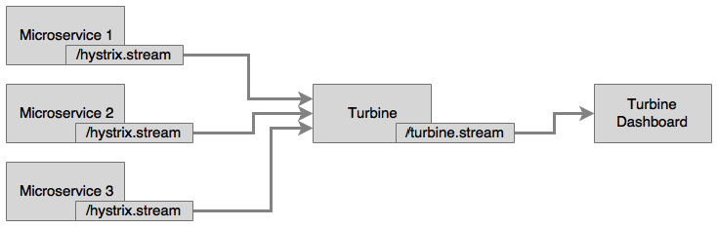
Aggregating Hystrix streams with Turbine
The Hystrix Dashboard can only monitor one microservice at a time.
If there are many microservices, then the Hystrix Dashboard pointing to the service has to be changed every time we switch the microservices to monitor.
We have to have a mechanism to aggregate data coming from multiple /hystrix.stream instances and consolidate it into a single dashboard view
Turbine is another server that collects Hystrix streams from multiple instances and consolidates them into one /turbine.stream instance.
Notes:
Turbine currently works only with different hostnames. Each instance has to be run on separate hosts. If you are testing multiple services locally on the same host, then update the host file (/etc/hosts) to simulate multiple hosts.
Once done, bootstrap.properties has to be configured as follows:
eureka.instance.hostname: localdomain2
This example showcases how to use Turbine to monitor circuit breakers across multiple instances and services. We will use the Search service and Search API Gateway in this example. Turbine internally uses Eureka to resolve service IDs that are configured for monitoring.

Slide 24
the example showcases how to use Turbine to monitor circuit breakers across multiple instances and services.
We will use the Search service and Search API Gateway in the example in pages [308-310]

Slide 25
Data analysis using data lakes
Fragmented data is another challenge in the microservice architecture, as it poses challenges in data analytics
This data may be used for simple business event monitoring, data auditing, or even deriving business intelligence out of the data.
A data lake or data hub** is an ideal solution to handling previous scenarios
When there is a state change, microservices publish the state change as events.
Interested parties may subscribe to these events and process them based on their requirements.
A central event store may also subscribe to these events and store them in a big data store for further analysis
Notes:
Check out the architecture of spoke and hub at https://en.wikipedia.org/wiki/Spoke%E2%80%93hub_distribution_paradigm
A data hub differs from a data lake by homogenizing data and possibly serving data in multiple desired formats, rather than simply storing it in one place, and by adding other value to the data such as de-duplication, quality, security, and a standardized set of query services. A Data Lake tends to store data in one place for availability, and allow/require the consumer to process or add value to the data.

Slide 26
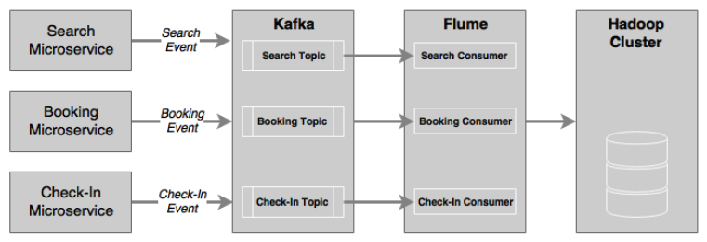
Common architecture for data handling

Slide 27
State change events generated from the microservice—in our case, the Search, Booking, and Check-In events—are pushed to a distributed high-performance messaging system, such as Kafka
A data ingestion service, such as Flume, can subscribe to these events and update them to an HDFS cluster
These messages will be processed in real time by Spark Streaming
To handle heterogeneous sources of events, Flume can also be used between event sources and Kafka
Spring Cloud Streams, Spring Cloud Streams modules, and Spring Data Flow are also useful as alternatives for high-velocity data ingestion

